Slide 1

Beginning Virtual Reality Development
@missLiviRose

Slide 2
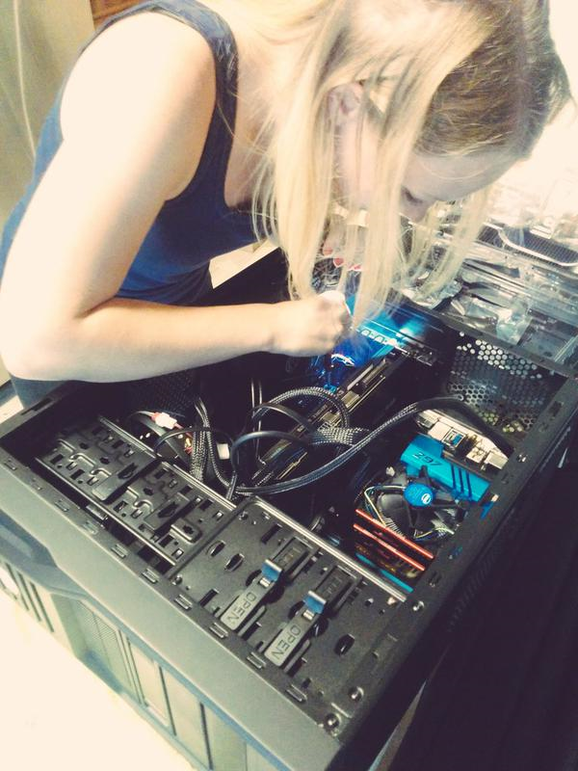
About Me
Livi Erickson
Livi.Erickson@Microsoft.com
Virtual & Augmented Reality Developer / Evangelist
VR Blog: The Matrix is my Office
Developer, KittenVR & KittenVR.com
@MissLiviRose on Twitter

Slide 3
Today’s Topics
Why Build for Virtual (and Augmented) Reality?
The VR Device Ecosystem
Breakdown of a VR application
Building a VR app: development ecosystem
Design Considerations & Concerns for VR today
Q & A

Slide 4
Immersive Computing for a 3D World

Slide 5
Virtual Reality
NOUN
the computer-generated simulation of a three-dimensional image or environment that can be interacted with in a seemingly real or physical way by a person using special electronic equipment
Notes:
Why do we care about virtual and augmented reality as a platform?
We live in a three dimensional world and computing in its current form doesn’t translate well into 3D experiences
Humans rely on their spatial awareness for so many things in the real world, and it’s time to make computing represent that as well
When we create fully immersive experiences, we can have profound impact on emotional response
Talk briefly about VR as a tool for:
Distraction (pain therapy)
Emotional well-being (phobia treatment)
Empathy
As well as:
How memories in VR form like real-world memories

Slide 6
The VR Device Ecosystem
Desktop // Mobile

Slide 7
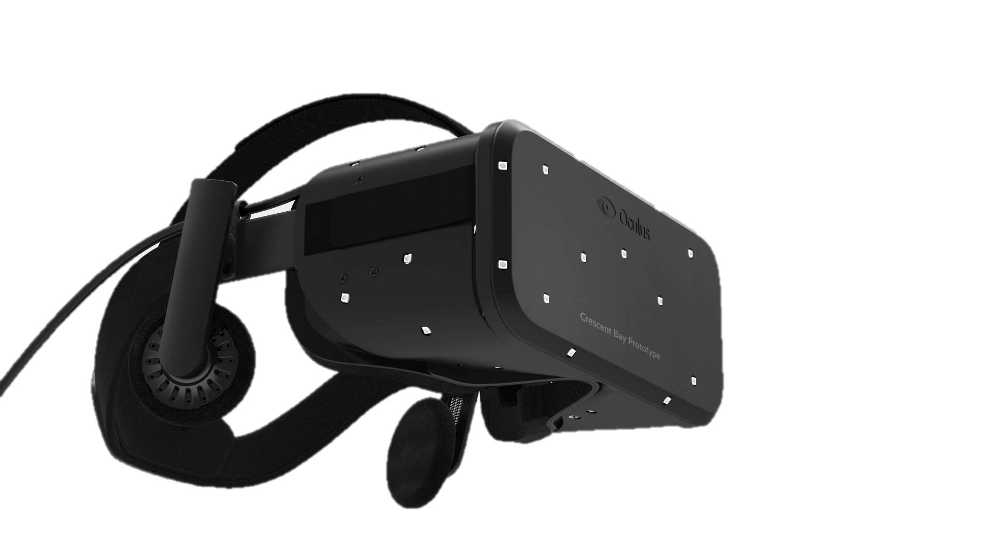
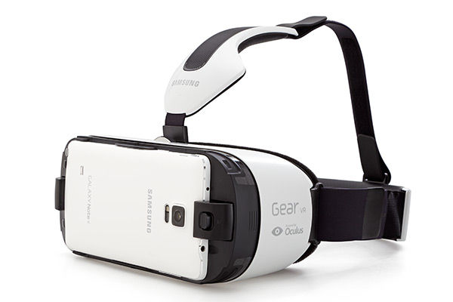
Head Mounted Displays
Head Mounted Displays (HMDs) can be desktop-powered devices or mobile-powered devices
Desktop: Separate display device self-containing screen, content provided externally from a separate PC
Mobile: Content provided and displayed by a smart phone inserted into the casing

Slide 8
Desktop Virtual Reality
Powered from external computers
Hardware includes separate screens
Treated as an external display at the hardware level
Software runs on the desktop and is passed to the display
Examples: Oculus Rift, HTC Vive, FOVE

Slide 9
Mobile Virtual Reality
Headsets are containers that support stereoscopic rendering for mobile phones
Applications are typical smartphone apps
The display is the phone screen
Usually, almost all computational aspects are done on the phone rather than the headset
Examples: GearVR, Homido, FreeFly, Cardboard

Slide 10
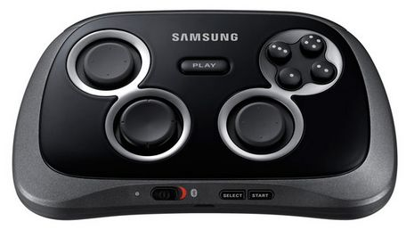
Input - Controllers
Traditional controllers somewhat solve the “I can’t see my hands” problem of VR
Navigation is less natural for movement with joysticks due to the sense of being in one place
Limited number of inputs / actions
Some apps may rely on specific types of input controllers and have compatibility problems

Slide 11
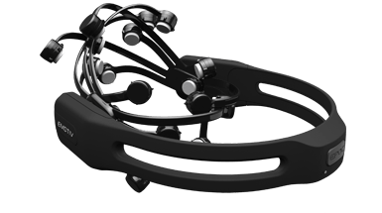
Input - Wearables
Devices that are lower profile and can be worn to control various inputs without specific controller input
Example: Nod Ring
Example: Myo Bracelet
Example: Emotiv Headset

Slide 12
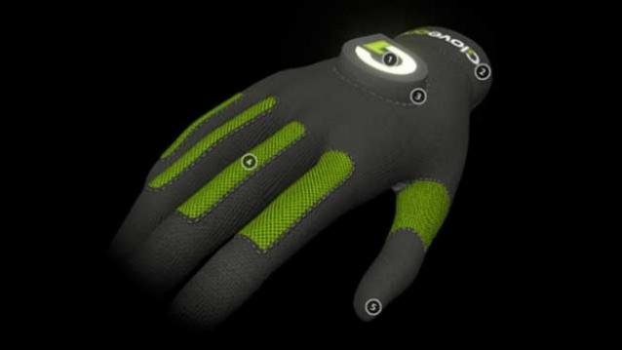
Haptics
Components to a VR system that provide tactile feedback based on what is going on in the virtual environment
Add to realism of a VR system by allowing the user to physically touch and experience things going on in virtual reality
Example: GloveOne (pictured) has multiple feedback points that mimic the sense of touch based on collisions in a VR game

Slide 13
Overview of a VR Application
Featuring KittenVR
Notes:
Ask the audience how many of them are game developers. Spend a little more time talking about the principles of game development cycles if most of them are unfamiliar. If the general body has a game development background, it will be okay to go through this part quickly.

Slide 14
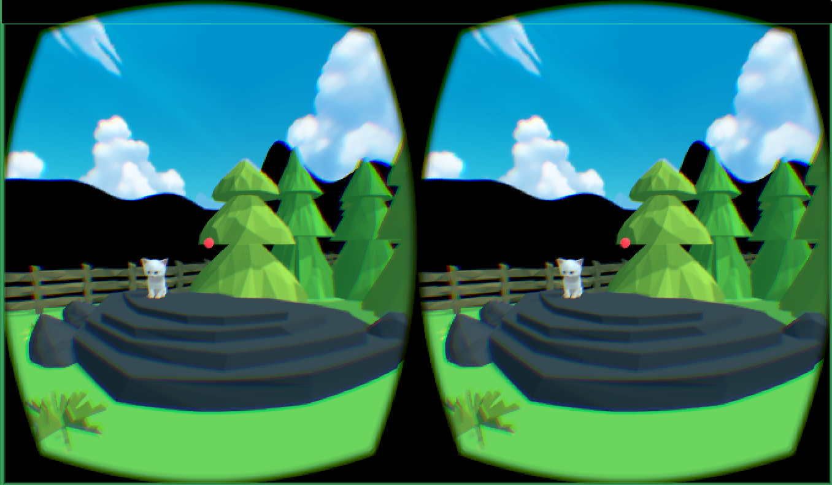

KittenVR
Made with Unity
C# Scripting
Oculus Rift (PC)
www.kittenvr.com

Slide 15
Render Loop
Hardware / Input Update
Game Logic
Lifecycle of a VR App

Slide 16
Render Loop
Hardware / Input Update
Game Logic
Game Logic
Defines the behavior of your application components
Models and textures are defined for your scene
Scripts control behavior of the scene objects
Generally doesn’t rely on the status of the hardware, but will likely contain checks for changes
KittenVR
Cartoon Environment
Kitten AI Behavior script
Gameplay script
Oculus Character Controller

Slide 17
Render Loop
Hardware / Input Update
Game Logic
Hardware / Input
Check on the orientation of the device to calculate how the camera should render objects in the scene
Evaluate if there are actions triggering different behaviors in your scene
Update scene variables or components based on input checks
KittenVR
Check for Oculus orientation change
Analyze for Xbox button presses matching the “collect” action
Move character with joystick changes

Slide 18
Render Loop
Hardware / Input Update
Game Logic
Render Loop
Evaluate the scene appearance based on the orientation of the headset
Apply effects based on changing scene (shadows, lighting, etc.) dynamically to match the user’s expectation
Draw to the headset / display
Example: If player has moved under a tree, update the shadows cast by the player accordingly
Playback | Required Refresh Rate
Film / TV | 24 – 48 FPS
Console Gaming | 30 FPS
PC | 50-60 Hz
VR | 75-120 Hz

Slide 19
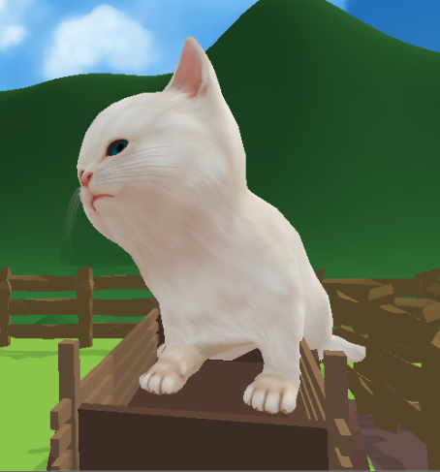
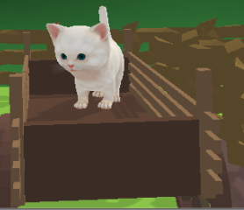
Presence in VR
Consider how your user will want to interact with the environment
Environment scale will impact how realistic a scene feels to a player
Non-autonomous character actions will break the sense of self
Notes:
Emphasize the importance of presence here:
In making people feel comfortable
In their actions being directly correlated to a VR action
Not to force action on the user
Describe the proprioceptive system

Slide 20
Display Performance & Considerations
Low Framerates = Motion Sickness
“Tearing” around the edges of the display
Shadowing (duplication) of scene objects at high framerates
Motion blur

Slide 21

Eyes: We’re Moving!
Body: No, we aren’t!
Body: We’re moving!
Eyes: No, we aren’t!
Motion Sickness

Slide 22
Tools of the trade
Unity, Unreal Engine, WebVR (Oh My!)

Slide 23
Development Options
Native development with the Oculus SDK
Game Engines:
Unity
Unreal
Web:
WebGL VR support through WebVR
Three.JS
KittenVR
Used the Oculus Unitypackage plugin for Unity 4.6
Upgraded to use built-in option for VR support in Unity 5.X
Notes:
Talk about how the options differ and why some may be more beneficial to others:
Native: Great for fine control, custom engine support, existing games, interesting control over effects and mono/stereoscopic
Game Engines: Awesome for not reinventing the wheel, provide a solid implementation of existing game components (e.g. lighting, physics, etc.)
Web: Lower performance, but great for experiments that utilize existing APIs and pull in data from the web

Slide 24
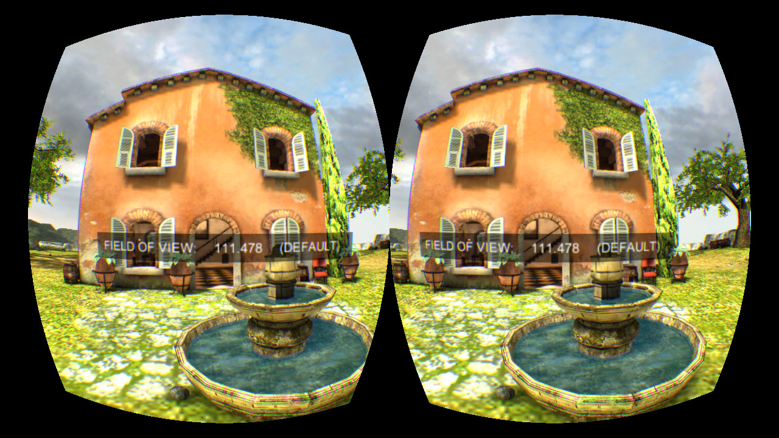
Oculus SDK
Add stereoscopic, distortion, and update effects within the graphics pipeline of your application
Render to a texture specifically output to the Oculus device as well as to a non-stereoscopic screen view
Great for custom game engines adding in VR support with the Rift
More customization and control granted
Versions available for desktop and mobile
Source: developer.oculus.com

Slide 25

Unity
Game Engine from Unity Technologies
Visual editor for environment building & scripting
Languages: C#, UnityScript (a JS derivative), Boo

Slide 26
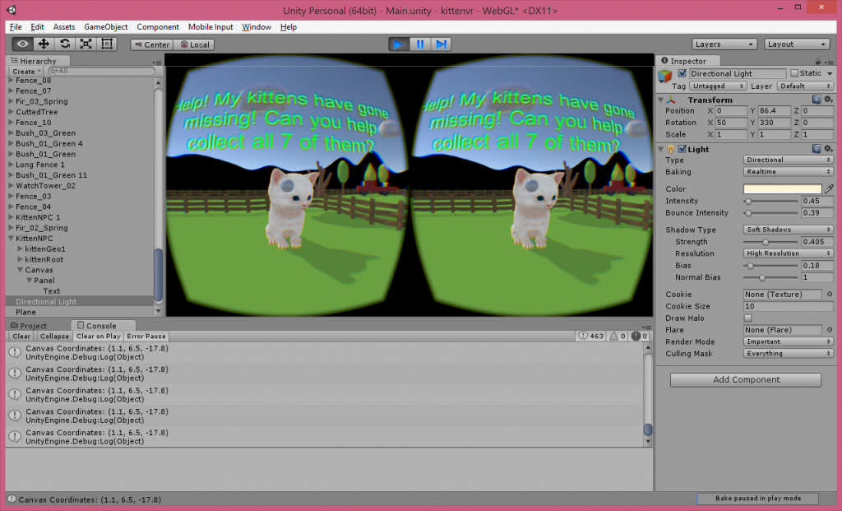

Slide 27
Unity: VR Mode
Unity 5.1+ has support for VR built in
Requires Oculus Runtime (available for Windows)
Implementing it:
Edit -> Project Settings -> Player
Under “Other Settings” check the ‘Virtual Reality Supported’ box
Will look normal until the Oculus is plugged in

Slide 28

Unreal Engine
Game Engine from Epic Games
Visual editor for environment building & scripting
Language: C++

Slide 29


Web VR
Flexible back end development
Front-end Rendering:
WebGL
Three.JS
Desktop & mobile support with one codebase
www.webvr.info
Notes:
Discuss how WebVR enables developers to use the same code base to run on mobile and desktop
Explain the specialized browsers required and how the browser handles hardware updates and transforms

Slide 30
Benefits of WebVR
No installation of application is needed – run in the browser on any device
Automatically support mobile and desktop devices
Utilize the current set of tools and libraries for JavaScript
Easily switch between VR and non-VR mode
Offload interfacing with hardware to the browser

Slide 31
Downsides of WebVR
Performance hits for non-native graphics
Non-standard support for some browsers
Less insight and control into bugs with hardware
Relies on browser detection of devices

Slide 32
Ready to Build?
3D Development
Scripting
Animation & 3D Modeling
Download Unity / Unreal

Slide 33
Planning a VR Application
Evaluate how the medium lends itself to your game or application
Minimize the amount of locomotion
Choose one platform to target at a time
Read up on best practices, but don't lock things in
Prepare to iterate - a lot!

Slide 34
Implementation of a VR App - My Strategy
Build out the basics in your environment so that you have a rough understanding of what your application components will do
Script the behaviors for gameplay elements & the rest of the application components
Finalize the environment with lighting, textures, effects

Slide 35
Testing your VR App
One person QA is not quite enough!
Variations in height, gender, life experiences, comfort with technology, etc. will all impact your user to a much greater extent in VR
Performance is hugely important to prevent motion sickness

Slide 36
Shipping Your App
First party app stores: Oculus Share, GearVR Store
Third party app stores: V, WearVR
Mobile app stores: Windows Store, Google Play, iOS app store
Standalone site

Slide 37
Example Apps

Slide 38
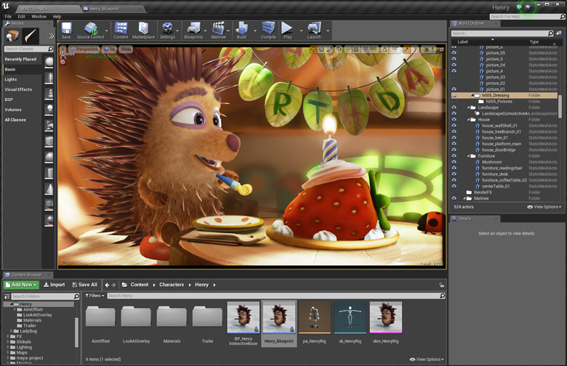
Oculus Story Studio
VR short clips
Built using Unreal Engine

Slide 39
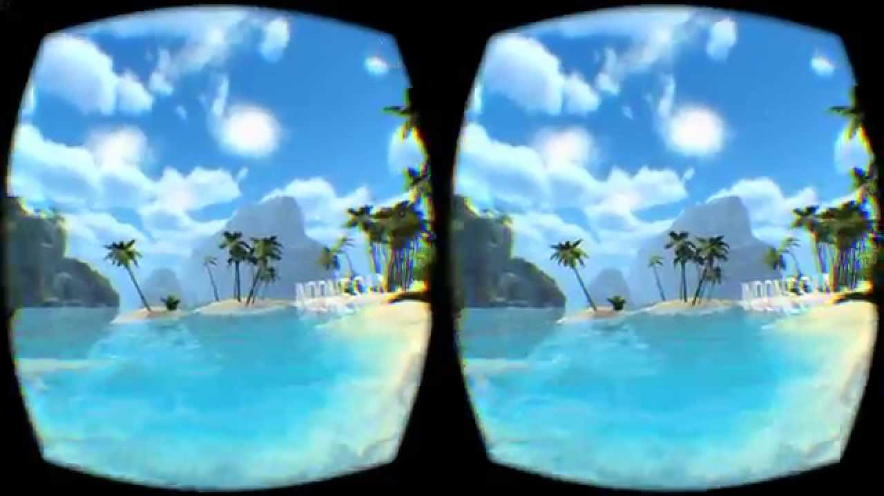
Guided Meditation
A series of meditation environments that help with relaxation
Voice narrator guides the wearer through a meditation session
Built with Unity

Slide 40
Rift Sketch
Live code 3D Environments in VR using an on-screen editor that changes the environment around you
Built on WebVR
Leap Motion camera pass through
http://brianpeiris.github.io/RiftSketch​

Slide 41
Final Considerations

Slide 42
Today's Challenges
Input devices are non-standardized across platforms
Different headsets may require specialized SDKs and have a degree of exclusivity
"We don't know what the killer app will be yet"
Uncertainty in market fit (But I'm optimistic :) )
Constant evolution in tools

Slide 43
My Resources
Blog: http://livierickson.com/blog for short-form VR development tutorials, reviews, and news
GitHub: http://github.com/misslivirose for all the code in my VR experiments (including Kitten VR!)
Informatica Feminale course materials: http://misslivirose.github.io/informatica_feminale
Learning Unity: http://livi.link/learnunity

Slide 44
Q & A
@misslivirose

